Slide 1
Update on 20 Nov, 2021
Big Data: Agriculture Development
Rashid, PhD Fellow
BUP
https://www.researchgate.net/profile/Md_Abdur_Rashid
https://orcid.org/0000-0001-8311-2363

Slide 2
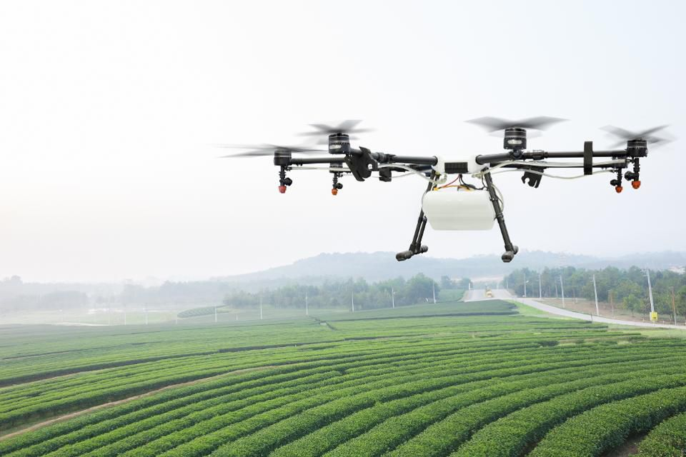
From Farm To Table
But according to McKinsey & Company, about a third of food produced is lost or wasted every year. Globally, that’s a $940 billion economic hit.
Inefficiencies in planting, harvesting, water use and trucking, as well as uncertainty about weather, pests, consumer demand and other intangibles contribute to the loss.
Big data is moving into agriculture in a big way.
Venture capital has flooded the ag tech space, with investment increasing 80% annually since 2012, as investors realize big data can revolutionize the food chain from farm to table.
How? Big data in conjunction with the Internet of Things can revolutionize farming.
https://www.forbes.com/sites/timsparapani/2017/03/23/how-big-data-and-tech-will-improve-agriculture-from-farm-to-table/#53ef70b65989

Slide 3
Advantages of data analysis in agriculture
Data helps debt-laden farmers, insurance agencies, loan banks, seed companies, machine industry and every big and small player. Data analysis not only creates greater awareness and more accurate knowledge, but it can also plug the lacunae in the supply and marketing chain of the industry.
Data mining is the computing process of discovering patterns in large data sets involving methods at the intersection of artificial intelligence, machine learning statistics and database system.
Ref: https://www.downtoearth.org.in/blog/agriculture/how-big-data-can-boost-agricultural-growth-65932

Slide 4


